Slide 1



Team #2
Solar Car Project
Detailed Design Review

Slide 2
Team Member
Mechanical Engineers
Electrical Engineers
Keith Dalick
Emiliano Pantner
Adrian Cires
Shishir Rajbhandari
James Barge
Zachary Prisland

Slide 3
Body

Slide 4
Tensile Testing 12K Carbon
Sample | Ultimate Testing (MPa) | Tensile Modulus (GPa) | Elongation (%)
1 | 149.40 | 5.51 | 5.18
2 | 154.22 | 5.30 | 4.39
3 | 124.09 | 5.66 | 3.337
4 | 120.46 | 5.17 | 5.81

Slide 5
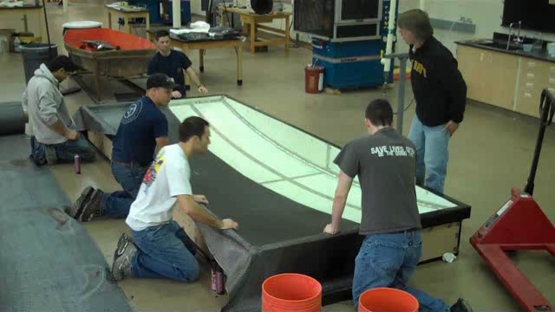
Making the Carbon Fiber

Slide 6
Suspension System

Slide 7
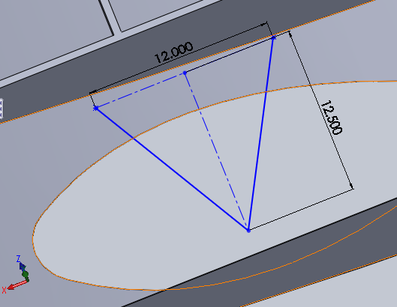
Current Status
Control arms designed
Short/Long arm design
  Lower control arm
    12.5 inches wide by 12.5 inches long
  Upper control arm
    12 inches wide by 12 inches long
  Maintains position of the contact patch in a straight vertical line under bump and rebound conditions
Attached to body and upright using Heim links

Slide 8
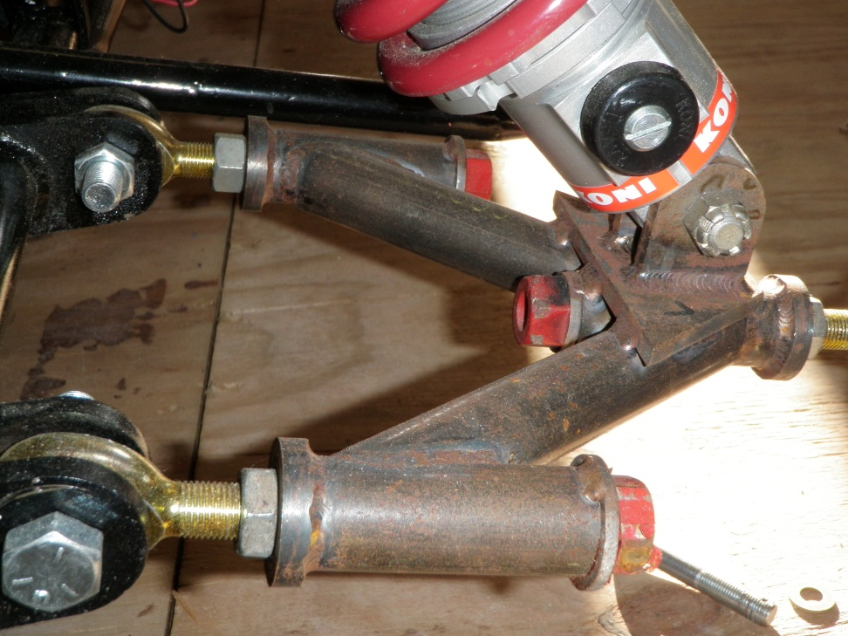
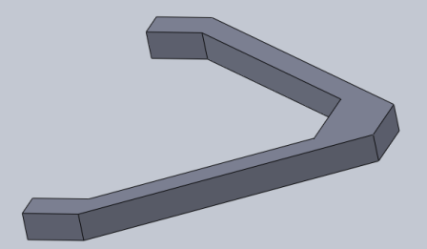
Control Arm
Old Design
New Design

Slide 9
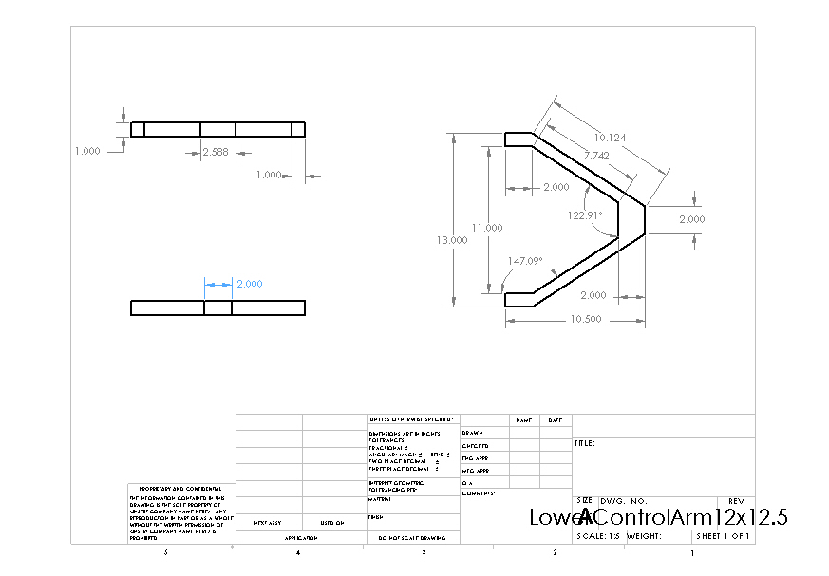
Lower Control Arm

Slide 10

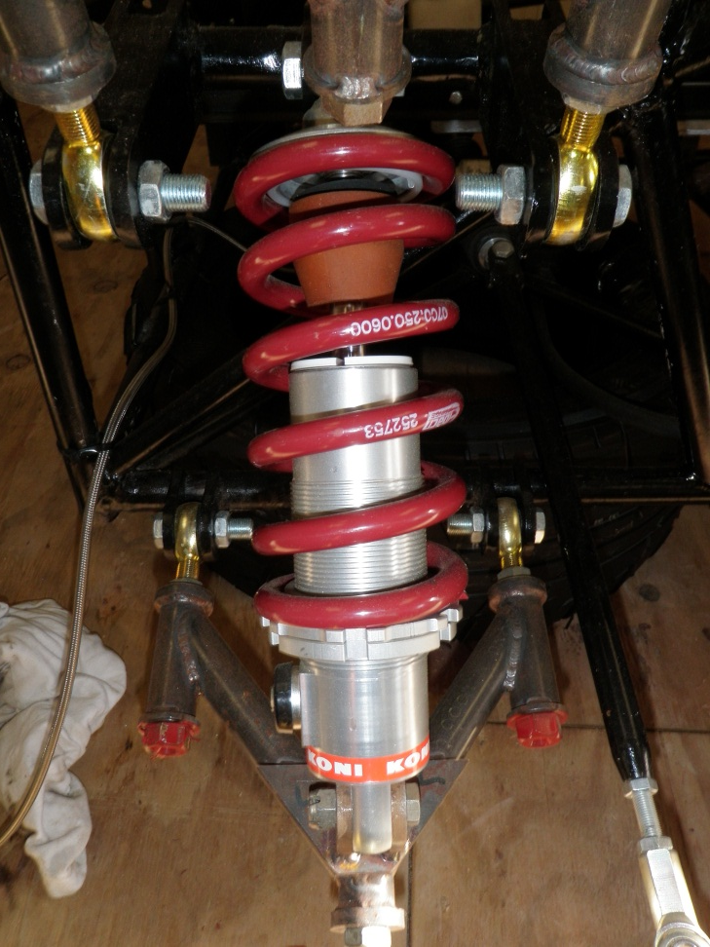
Shocks
Old Shock
New Shock (FOX Van RC)

Slide 11
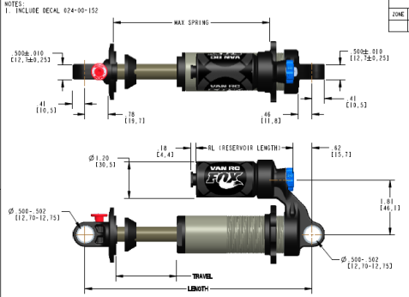
Fox Shox Vanilla R Coil Shock
2005 model
7.875 X 500 X 2.30
0.85 lbs
Externally adjustable rebound damping
Adjustable coil spring preload

Slide 12
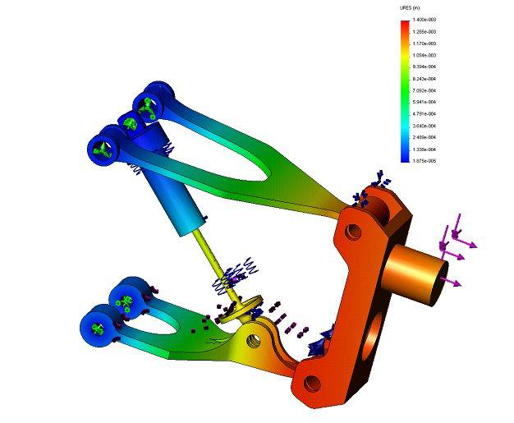
Test Plan
Component testing
  Hiem joint
  Control arm
  Mounting Brackets
  Upright arm
  Front Suspension
  Rear Suspension
Suspension system finite element analysis (FEA)
Suspension system virtual simulation

Slide 13
Braking System

Slide 14

Current Progress
Sponsored by Wilwood Engineering
Discount prices on various brake components
  Brake Calipers
  Master Cylinders

Slide 15
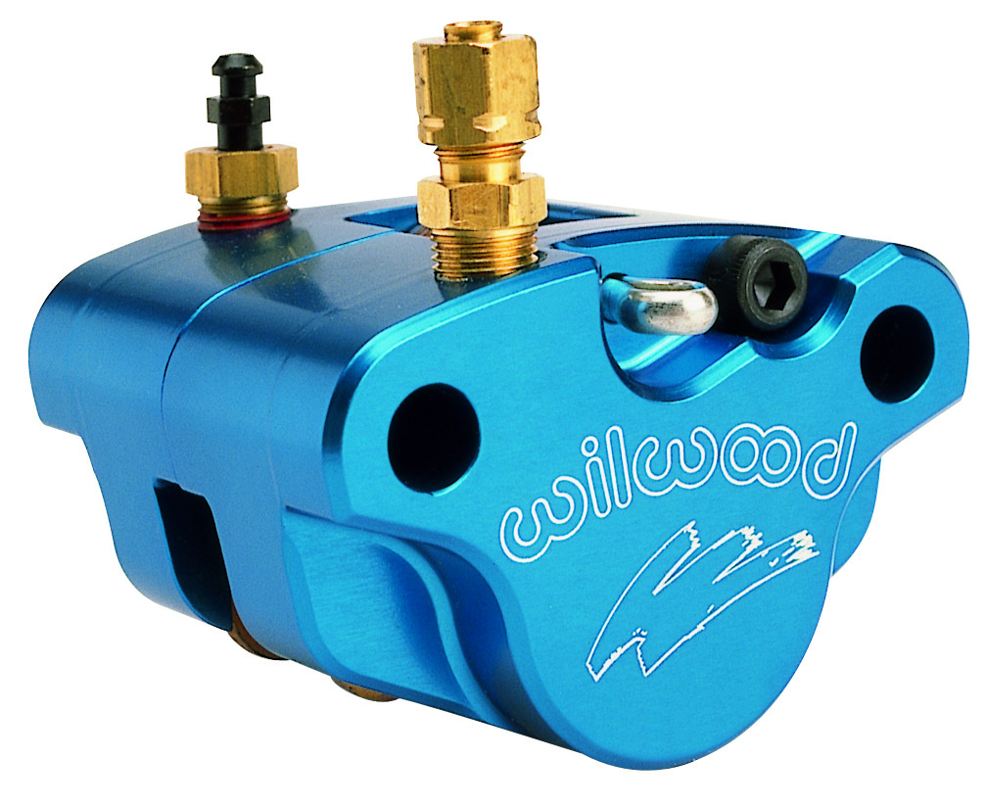
Brake Caliper
Go-Kart brake caliper
Suitable for solar car’s lightweight
Features:
  Self retracting and adjusting piston
  Steel piston for reduced heat transfer

Slide 16
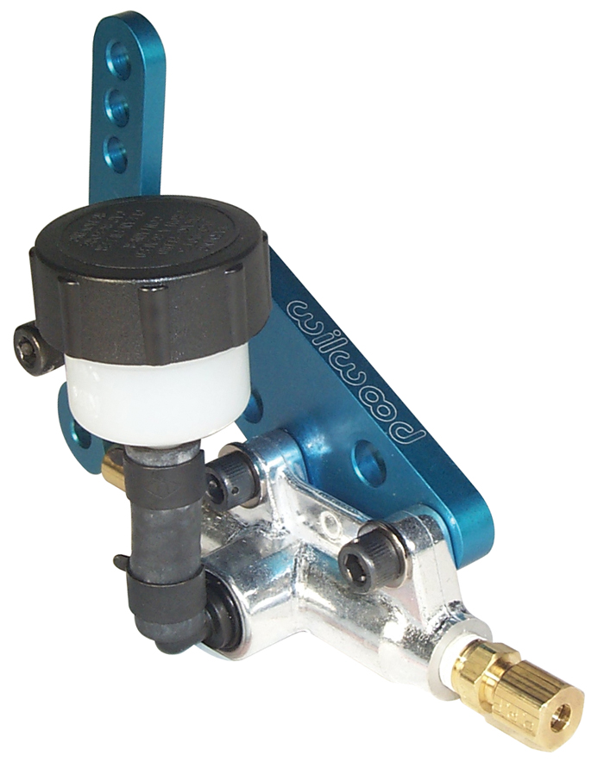
Master Cylinder
Go-Kart master cylinder
Specifically designed for use with selected caliper
Features
  Adjustable lever ratio
  Lightweight aluminum cylinder

Slide 17
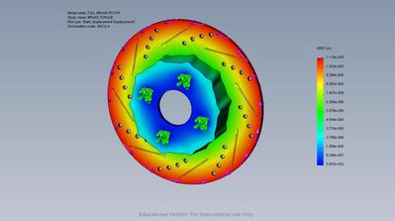
Brake Rotor
Brake rotor will be custom built
  To fit new spindle
Modeled in SolidWorks
  FEA tests for heat dissipation/stress
Utilize machine shop for fabrication

Slide 18
Power Generation System

Slide 19
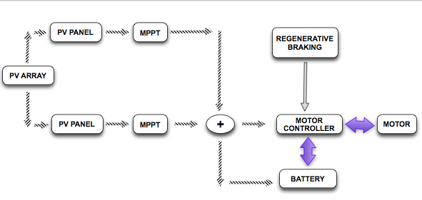
Power Generation

Slide 20
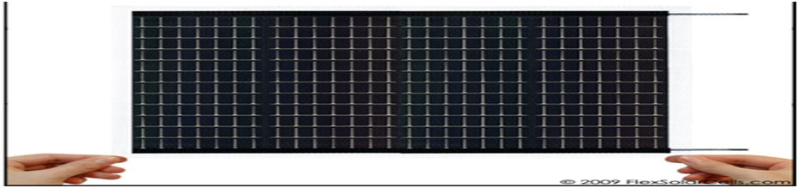

FLEXS SOLAR CELLS : PT15-300
Voltage | 15.4 V
Current | 200 mA (0.2 A)
Voltage (oc) | 19.0 V
Current (sc) | 240 mA (0.24 A)
Thickness | 1.1 mm
Total size | 10.6 in. x 12.8 in.
Weight | 3.3 oz (94.5 g)

Slide 21
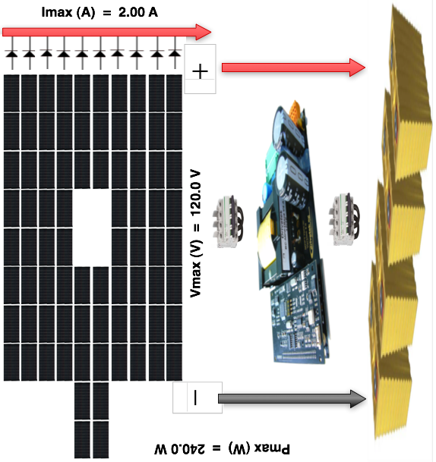
SOLAR ARRAY – PT15

Slide 22
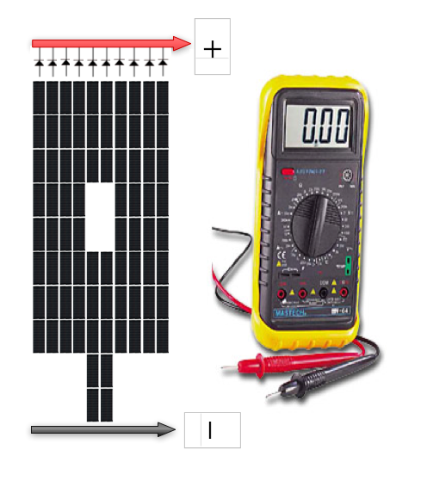
Test – Solar
Test solar module for rated Voc (V) and rated Isc (I)
Test solar array for rated Voc (V) and rated Isc (I)
Solar array should be covered to measure the current

Slide 23
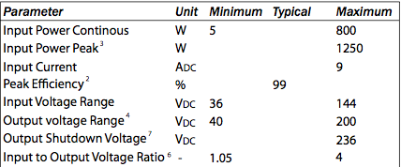
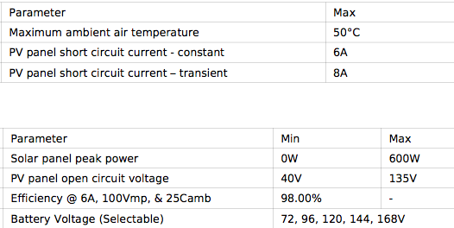
MPPT
DRIVETEK RACE
AERL 600 B

Slide 24
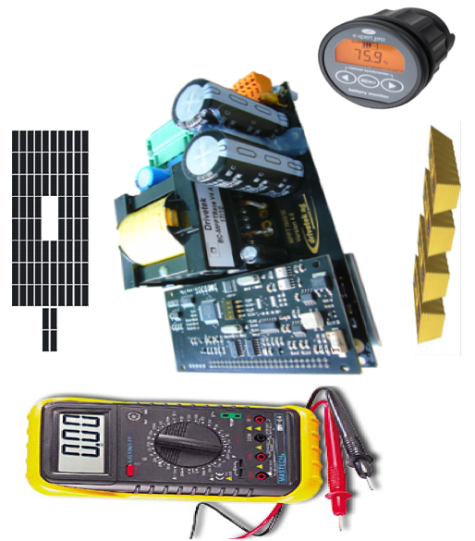
TEST - MPPT
Test MPPT for input and output voltage (V)
Test MPPT charges the battery bank

Slide 25
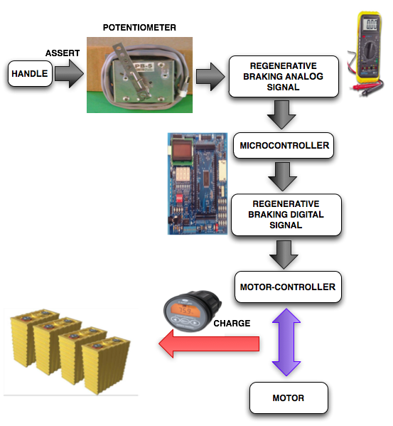
REGENARATIVE BRAKING

Slide 26
Control System

Slide 27
Current Status
Power control system components have been purchased
Problems with motor controller communication
Component testing in progress

Slide 28
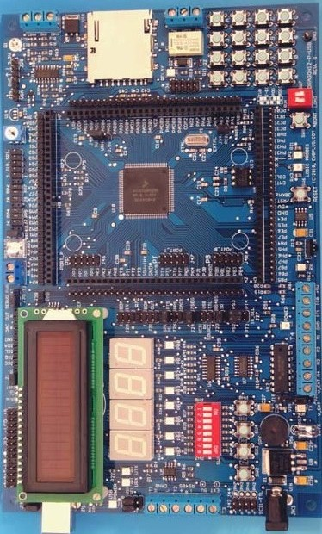
Master Control Unit
Power control code is complete
Code to transmit data to motor controller is complete
User input code in progress
Code to process motor controller data in progress

Slide 29
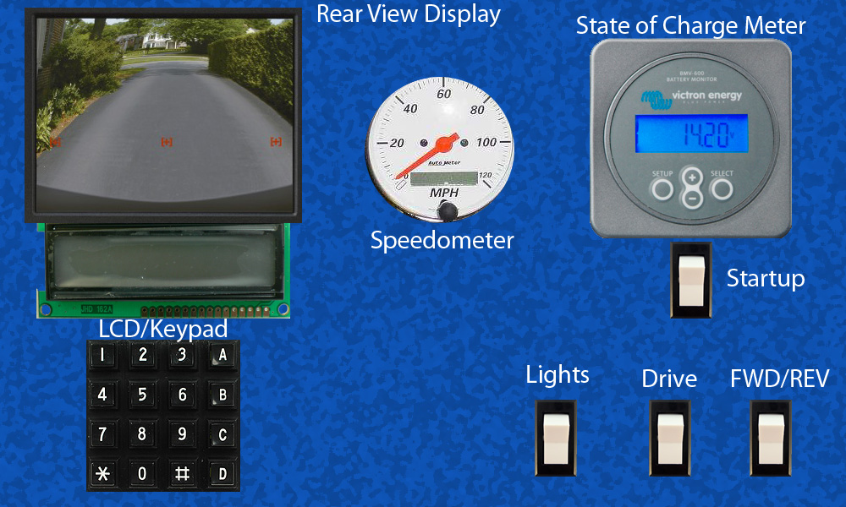
Dashboard

Slide 30
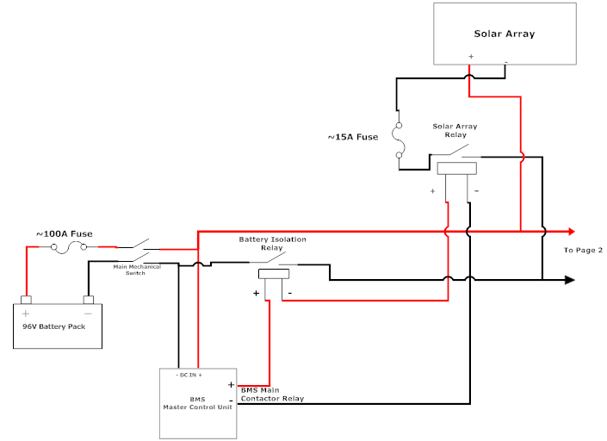
Power Control

Slide 31
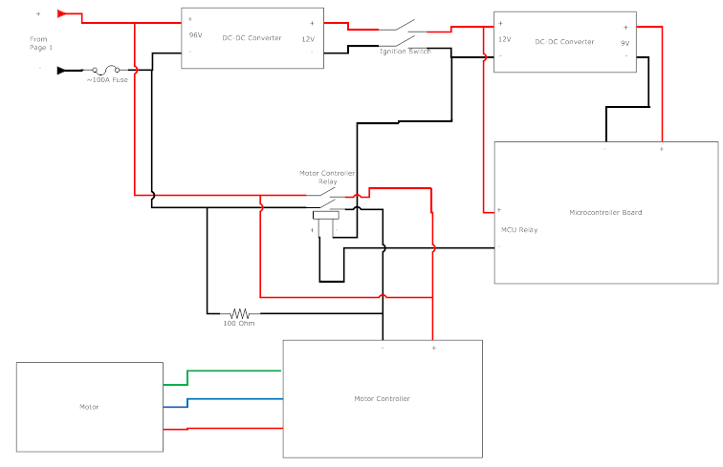
Power Control

Slide 32
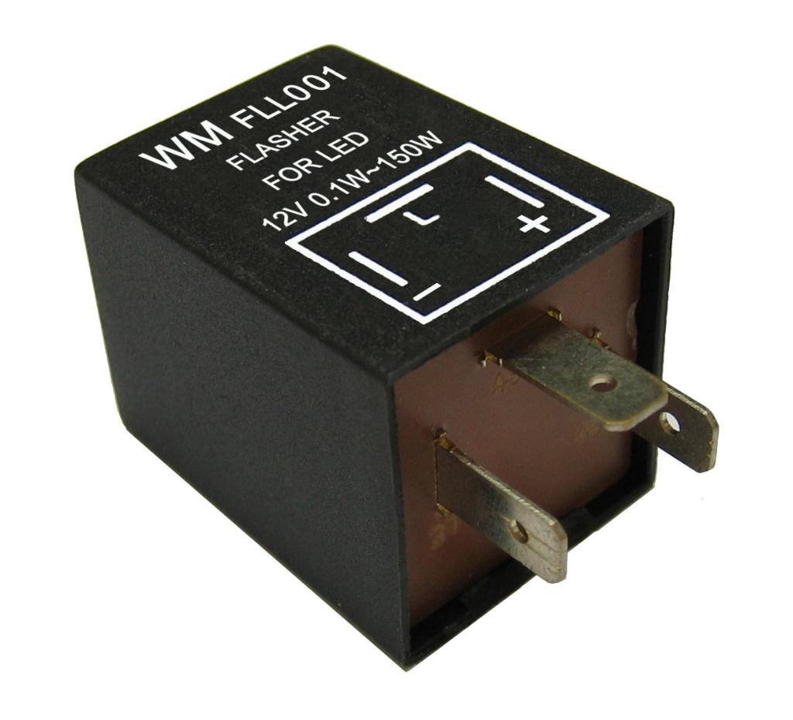
Lights
Front lights controlled by rocker switch on dashboard
Brake lights controlled using a relay activated by motor controller
Electronic LED flashers used to control turn indicators

Slide 33
Test Plan
MCU Software Simulation
Power system component testing
Dashboard component testing
Power system integration
Dashboard integration
MCU/Motor controller integration
Electrical system integration

Slide 34
Management System

Slide 35
Overview
Management System
Stored Energy
Propulsion
Batteries
Protection Circuit
Wall Charging
State of Charge
Motor Controller
Motor

Slide 36
Battery Box Update
Dividing batteries into three separate boxes
Built out of fiberglass
All boxes will be placed at the front of the car
Quick disconnects for each individual box
Dimension | Size
Length | 20"
Width | 6"
Height | 8"

Slide 37
Battery Risks
Protection Type | Restraining Value
Over Voltage | 4.25 V
Under Voltage | 2.5 V
Over Current | 120 A
Over Temperature | 75 °C
Operating in unsafe conditions
Incorrect wire gauges
Lack of proper insulation
Any incidental contact with driver

Slide 38
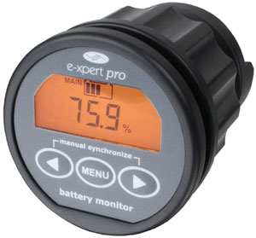
State of Charge
Dashboard display
Battery fuel gauge
Shunt line current measurements
Microcontroller interface capabilities

Slide 39
Budget & Schedule

Slide 40





Budget
System | Cost
Body | $7,396
Suspension | $665
Braking | $840
Power Generation | $8,807
Control System | $636
Management System | $609
Grand Total | $18,953
Donations | $7,486
Net Total | $11,467
Budget Estimate after Donations: $11,467
Budget given by University: $5,000
Budget Deficit: $6,467

Slide 41
Major Milestones
System level design review November 15, 2010
Assemble lower body December 16, 2010 (February 2, 2011)
Assemble upper body January 21, 2011
(TBA)
Detailed design review and test plan January 27, 2011
Configure lower body February 21, 2011
Install solar arrays February 23, 2011
Total body configuration March 15, 2011
Final testing March 29, 2011

Slide 42
Questions???

